Slide 1
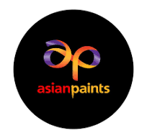
SUPPLY CHAIN ANALYSIS OF ASIAN PAINTS

Slide 2

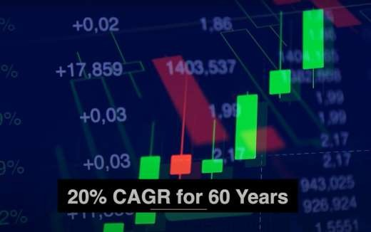
▶ Asian Paints has been the market leader in the paint industry for the last 54 years, with sales doubling almost every three years. The most remarkable aspect of this firm is that it is the only one to have achieved a compound annual growth rate (CAGR) of 20% over the previous 60 years.

Slide 3
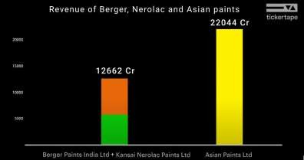
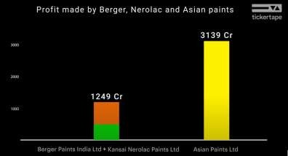
▶ If you compare Asian Paints to its rivals in Tickertape, you'll find that Asian Paints made a profit of Rs 3,139 crores on its own, while Berger's profit was Rs 719 crores and Nero Lac’s profit was Rs 529 crores.

Slide 4
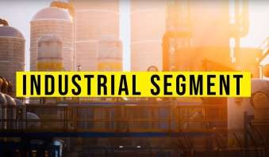

▶ There were two distinct markets inside the paint business. Both the commercial and residential/decorative paint markets were represented. Supplying paint to massive manufacturing facilities and processing plants was the main focus of the business-to-business market in the industrial sector. In contrast, selling paint to the general public for use in interior decoration was a b2c, or business-to-consumer, activity.

Slide 5
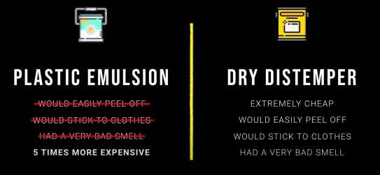
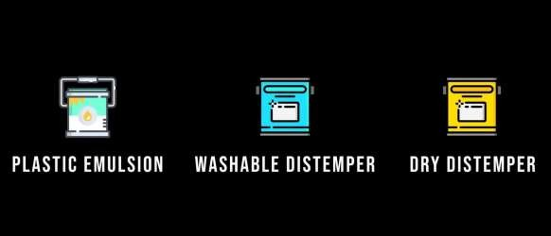
▶ In order to bridge the gap between dry distemper and plastic emulsions, Asian Paints developed a revolutionary product they named washable distemper.
This product changed the game since it mimics the properties of plastic emulsion but costs much less to produce. The slogan "Don't lose your temper, use tractor distemper" was used in the product's effective advertising campaign.

Slide 6
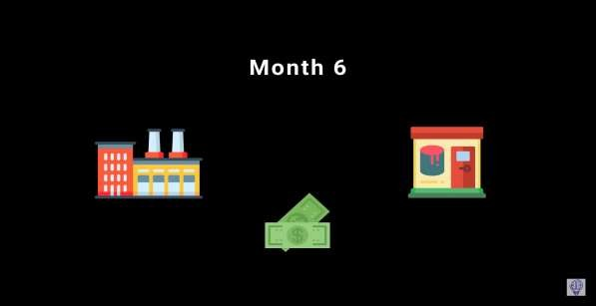
During that time, large multinational corporations used to offer at least 180 days of credit period to their distribution channel and this included the shopkeepers, the dealers, and the distributors, who supplied paints to retail customers.
which means that you need an exorbitant amount of working capital to even survive in the market. This is the reason why the smaller players found it very difficult to enter the market. So the entry barrier was very very high. But the one practice that was prevalent and even today it is still prevalent in any credit system is that even if the shopkeepers have sold Rs 60,000 worth of paints, then they have got 180 days to pay back, no one really bothers to pay back.

Slide 7


wherein the regular payback was incentivized.For example, a shopkeeper would get a 3.5% extra discount if he made the payments within 30 days throughout the year.
Similarly, if a dealer made payments in cash, they would get a 5% discount on his procurement price. Now, this was a very, very big deal because the paint industry by default operated at razor-thin margins at the dealer level. And these initiatives worked wonders because it was a win-win for both Asian paints and the dealers.

Slide 8

And they use these mainframes to forecast demand by which they could run their supply chains at insane levels of efficiency. They started branch billing on computers way back in the 1970s. And even started using GPS for tracking the movements of their trucks.
Well, in 1980, the Bhandup plant used to operate with 1600 workers, but Ankhleshwar started production for the same capacity with only 250 workers. And by 1985, the same thing was done with less than 100 workers. So you see, in less than five years, they were able to improve their efficiency to such an extent that now they were able to operate at the same capacity with 1/16 of the workforce. All of this was done because of insanely superior technology

Slide 9
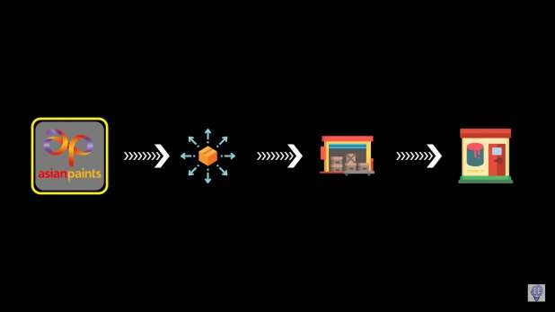
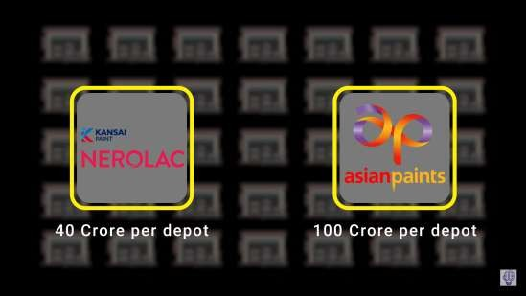
from the 1970s onwards, Asian Paints removed all middlemen like distributors and wholesalers from its distribution channel. And this meant that they were supposed to supply directly to the dealers and because of this today, Asian Paints manufacturer reaches 70,000 paint dealers without any channel intermediation.
Therefore, with only 3 to 5% average margin for the dealers, Asian Paints is able to keep 95 to 97% of the
margins for itself.
Meanwhile, the extraordinary levels of efficiency have taken Asian paints to such heights that even today with 125 depots in its supply chain, while Nerolac generates a revenue of Rs 40 crore per depot, Asian Paints generates revenue of Rs 100 crore per depot. Similarly, the revenue per factory for Nerolac is at Rs 700 crores, whereas Asian Paints stands way ahead at a revenue of Rs 1500 crores.

Slide 10

factor and that is a relationship with dealers. A classic example of the same
was the distribution of something called tinting machines.
while Nerolac and Berger together deploy 46,000 tinting machines through their dealer network, Asian Paints alone has 50,500 machines.
back then the problem was that tinting machines were manufacturer-specific, they required significant space in the store and they were extremely costly. And while many paint companies asked the dealers to bear the heavy cost, Asian paints used to bear the initial investment, and then it would give the machine on a lease agreement to the dealers. This way, the dealers felt less burdened, and the company established a solid relationship with its dealers. Therefore, the entry barrier even for small players was almost eliminated. This is the reason why the network Asian Paints grew from just 15,000 dealers in 2001 to 52000 dealers in 2018 because even the smallest dealer in the market could afford to partner with Asian Paints.

Slide 11
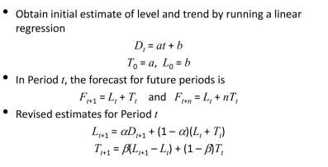
Forecasting
29,000.00
24,000.00
19,000.00
14,000.00
9,000.00
4,000.00
MAR MAR MAR MAR MAR MAR MAR MAR MAR MAR MAR MAR MAR MAR MAR '08 '09 '10 '11 '12 '13 '14 '15 '16 '17 '18 '19 '20 '21 '22
There is a trend but no seasonality.
Suggesting to follow exponential smoothing with trend adjustment model (Holt Model).

Slide 12
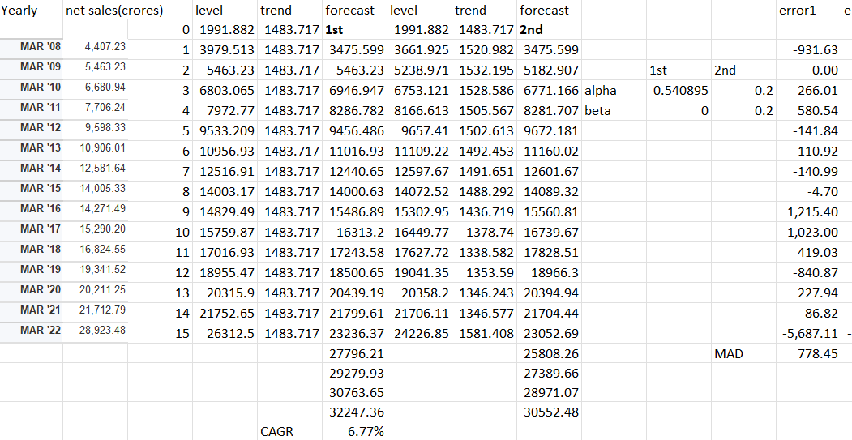

Slide 13
Forecast vs Actual
35,000.00
30,000.00
25,000.00
20,000.00
15,000.00
10,000.00
5,000.00
0.00
1
2
3
4
5
6
7
8
9
10
11
12
13
14
15
Series1
Series2

Slide 14
VRIO Analysis
▶ V-Value of the resource
▶ R-Rareness of the resource
▶ I-Imitation Risk
▶ O-Organizational Competence
Resources | Value | Rare | Imitable | Organization Competence | Competitive advantage
Product | Yes | No | Yes | Yes | It has a short- term competitive advantage
Supply chain | Yes | Yes | No | Yes | It has long- term advantage

Slide 15
Product
▶ Valuable-we spend around 20-30% capital on the paints, which is a significant amount of capital. Thus, it is a valuable product.
▶ Rare- We can not only buy these products from Asian paints, but we have more options like Berger paints and Nerolac.
▶ Imitable-can be imitated by the competitors.
▶ Organizational competence-R&D has been very good, and the sales of the new products were also very good.

Slide 16
▶ Valuable - In 1980, just 250 were needed to get production going at the Ankhleshwar plant. And by 1985, they did the same thing with less than a hundred workers, having increased efficiency to the point that they could perform the same task with one-sixteenth of the staff.
Supply chain
▶ Rare - In 1970, Champak Lal Choksey spent Rs 8 crore on India's first-ever supercomputer. These supercomputers are used for demand forecasting, allowing for supply chain optimization on an unprecedented scale.
▶ Imitable - During that period, enormous multinational corporations gave a credit term of at least 180 days to their distribution channel, consisting of shops, dealers, and distributors who sold paints to retail customers As a result of taking this method, the distributors were in a position to extend the credit period even more, all the way up to a whole year. Which made a large amount of capital required to enter the market and thus eliminating the chance of competition or imitation
▶ Organizational competence - Starting in the 1970s, Asian Paints cut off all wholesalers and distributors from its supply chain. As a result of being required to provide directly to the dealers, Asian Paints is now able to access 70,000 paint dealers directly without the need for any kind of channel intermediation. Asian Paints is able to preserve 95–97% of the profits.

Slide 17
Concerns for the company:
▶ Crude oil impact: The raw materials for paint companies are crude oil derivatives such as zinc oxide, and titanium dioxide, solvents such as turpentine, and other additives. An increase/decrease in crude oil prices directly impacts the cost of raw materials for paint companies.
▶ Raw materials costs account for about 50% of its revenue (nearly 55-58% of its total expenses). So, any increase in this affects the operating profits and puts pressure on the margin.

